Slide 1
Title: Exam Stress and Its Impact on Academic Performance
Presented By :
Aachal Patil(24104001)
Mahesh Bharambe(24104069)
Guide name: Prof. Kalyani Neve
Course Name: MCA 2nd Year

Slide 2
Abstract / Introduction:
Exam stress is a common issue among students at all levels.
It can negatively influence concentration, memory, and academic performance.
Stress arises from multiple factors such as lack of preparation, pressure from parents/teachers, peer competition, and time management issues.
This study explores the causes and effects of exam stress and its relationship with performance.

Slide 3
Objectives / Research Questions:
To identify the major causes of exam stress among students.
To analyze how stress levels affect academic results.
To suggest strategies for reducing exam stress.
Research Question: Does exam stress have a significant impact on academic performance?

Slide 4
Problem Statement:
Exams = major cause of stress among students.
Excessive stress → anxiety, depression, health issues.
Competition & grade pressure intensify stress.
Limited mental health support in institutions.

Slide 5
Literature Review :
Prior studies (Kumari & Jayanthi, 2014; Deb et al., 2015) found stress is linked to poor academic outcomes.
High achievers often internalize stress due to feara of failure.
Lack of time management and preparation are strong predictors of exam anxiety.
Emotional and social support (family, peers, teachers) reduces negative impact.

Slide 6
Methodology:
Sample Size: 100–110 students.
Data Collection Tool: Standardized questionnaire (Likert scale) on exam stress.
Performance Measure: Latest exam scores.
Analysis: Frequency, percentage distribution, and comparison of stress vs. academic scores.

Slide 7
Tools and Technologies Used:
Google Forms – Used for creating and collecting online survey responses.
Microsoft Excel – Used for data analysis, tables, charts, and graphs.
Microsoft Word – Used for report writing and formatting.
Statistical Techniques – Percentage analysis, comparative analysis, and correlation analysis.
Internet Sources – Used for collecting secondary data from journals and research papers.
Survey Methodology – Structured questionnaire and sample survey technique used for data collection.

Slide 8
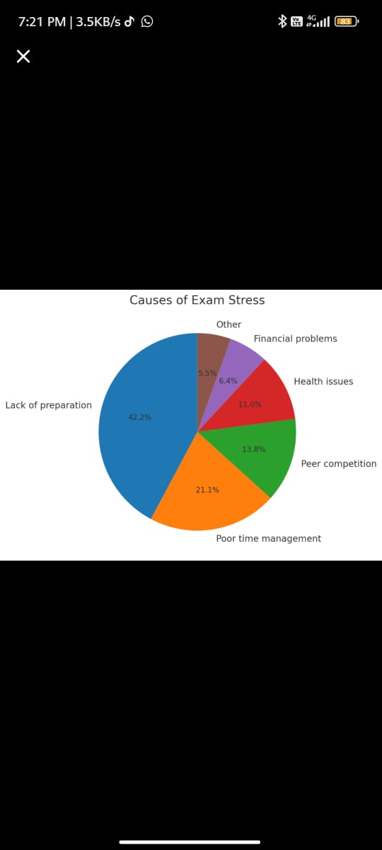
Results / Findings:
Majority of students reported experiencing exam stress.
Key causes:Lack of preparation time (42%)Poor time management (21%)Peer competition (14%)Health issues (11%)Financial difficulties (6%)High stress levels were linked to lower academic scores.
Students with better preparation and time management performed higher.

Slide 9
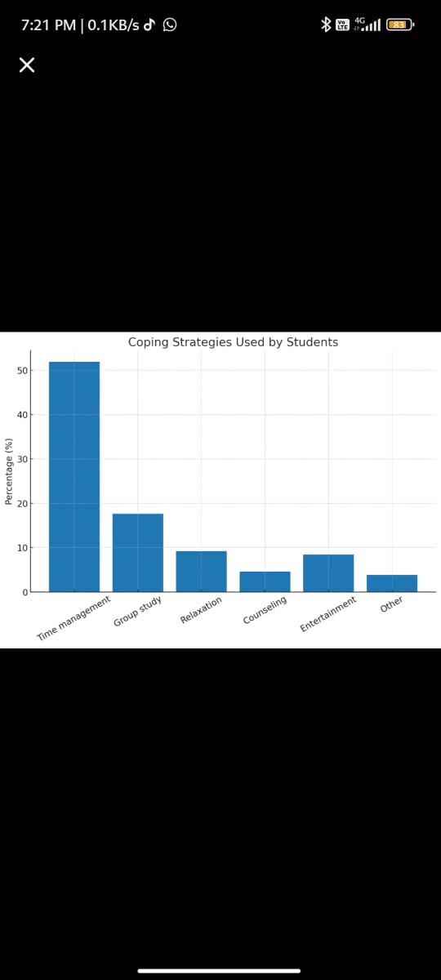
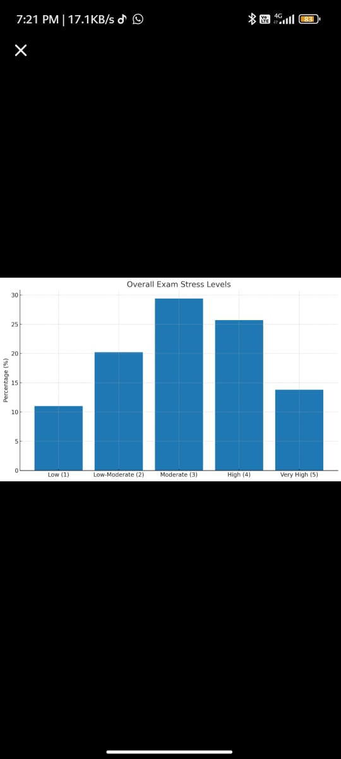
Coping StrategiesHighlights that time management/study schedules (51.9%)are the most common coping method, while only 4.6% use counseling.
Overall Exam Stress LevelsIndicates that most students experience moderate to high stress (29.4% + 25.7%), while fewer report very high stress (13.8%).

Slide 10
Discussion:
Stress has both positive and negative impacts:
Positive: Mild stress motivates students to prepare better.
Negative: High stress reduces concentration, causes anxiety, and lowers performance.
Peer and parental pressure increase psychological burden.
Proper coping strategies can improve performance.

Slide 11
Conclusion:
Exam stress is a major factor affecting academic outcomes.
Most students experience it, mainly due to preparation and time issues.
Excessive stress leads to:
Anxiety
Memory loss
Poor concentration
Stress management is essential for improving both mental health and academic results.

Slide 12
Recommendations / Future Scope:
Encourage time management training for students.
Provide counseling and stress management workshops.
Parents and teachers should create a supportive environment instead of adding pressure.
Future research: larger sample, include psychological and physiological measures.

Slide 13
Thank You !

